Slide 1
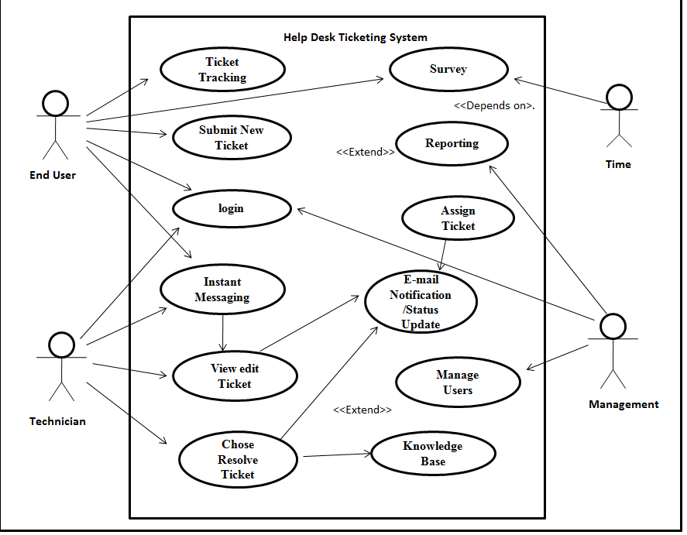

Slide 2
dd
he
Ticket Tracking
Survey
Submit New Ticket
Reporting
login
Assign Ticket
Instant Messaging
E-mail
Notification/Status Update
View edit Ticket
Manage Users
Chose Resolve Ticket
Knowledge Base

